Slide 1
CAR Administrator Calibration Meeting - CAR Review -
February 26 2013
Team A: Paul Ip, Thomas Kestner, Balina Ling, Kila Yang

Slide 2
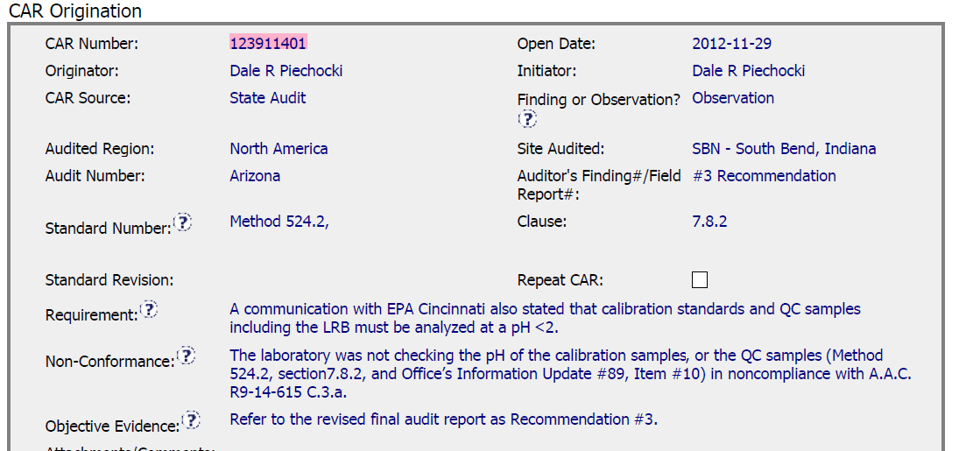
CAR No. 123911401
State Audit for Water Quality
Observation
NC: According to requirement, a technical data from samples was not checked

Slide 3
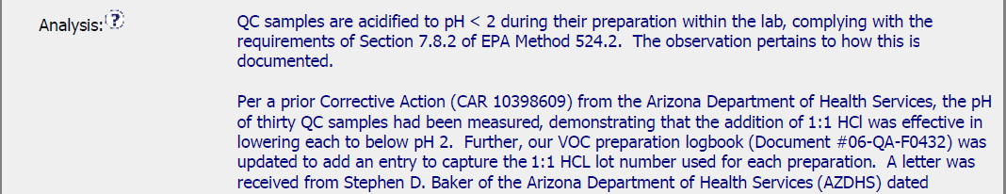
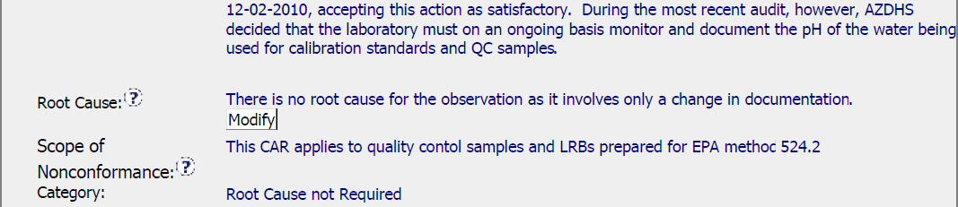
CAR No. 123911401
Analysis : Provided although it was an observation CAR. CAR Owner provided much information to explain UL meeting the requirement, just only not record the data in Datasheet. Therefore, it would be reporting issue instead of technical issue. Thus, considered this CAR to be an OBSERVATION rather than FINDING.
It was considered as a good practice
Root Cause : Not Required
Scope of Nonconformance: limited to the objective evidence provided for the nonconformance.
Category: Root cause not required

Slide 4
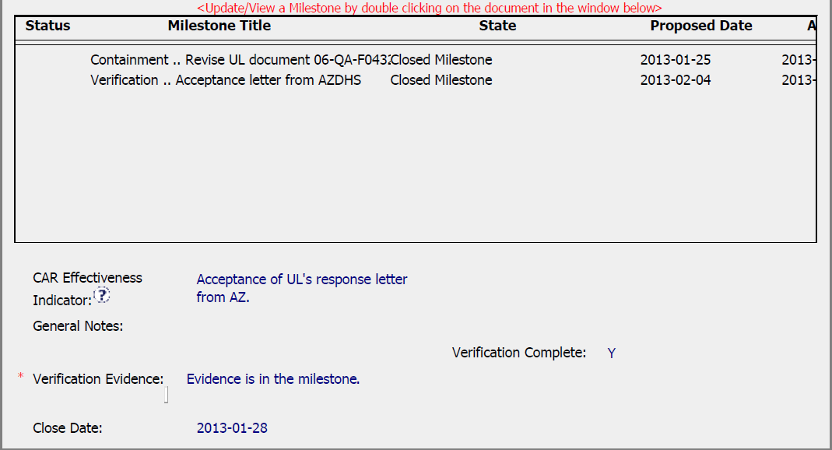
CAR No. 12311401
Milestone: Completed per milestone expectation and provided enough evidence
Verification: Occurred immediately after acceptance of the last milestone

